Slide 1

Mission 5: trademe

Slide 2





Resources Used

Slide 3
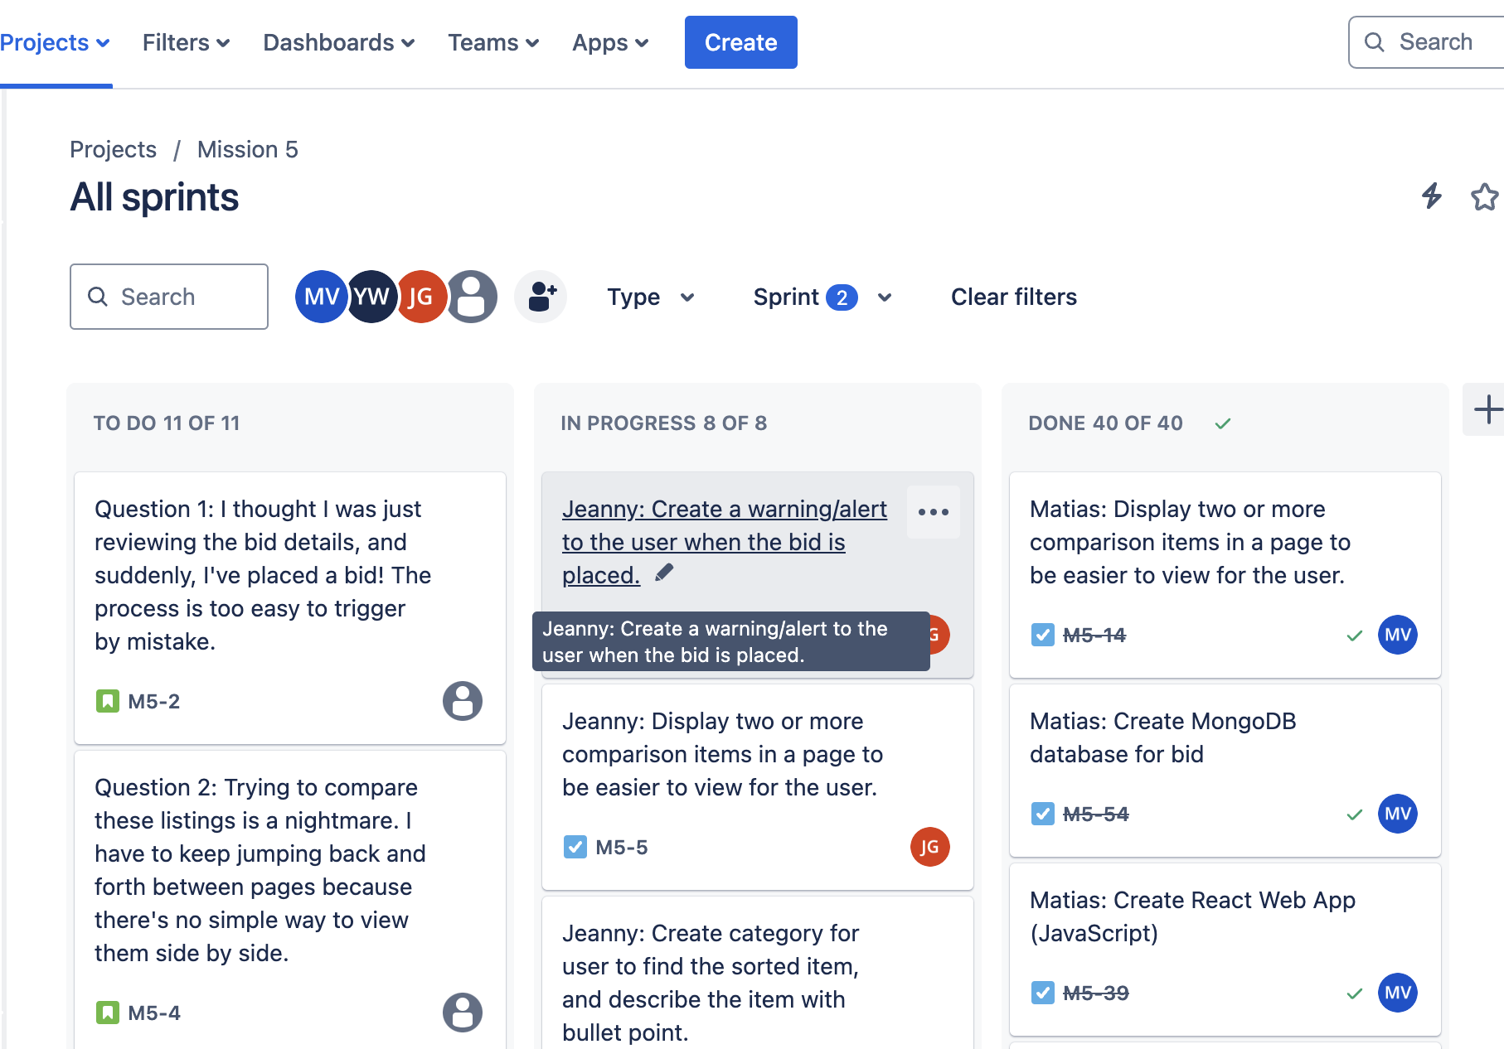
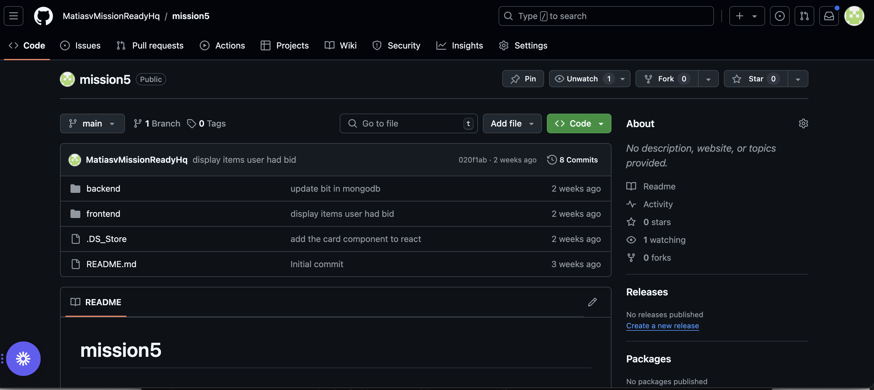
Jira & GitHub
GitHub Repo -https://github.com/MatiasvMissionReadyHq/mission5

Slide 4
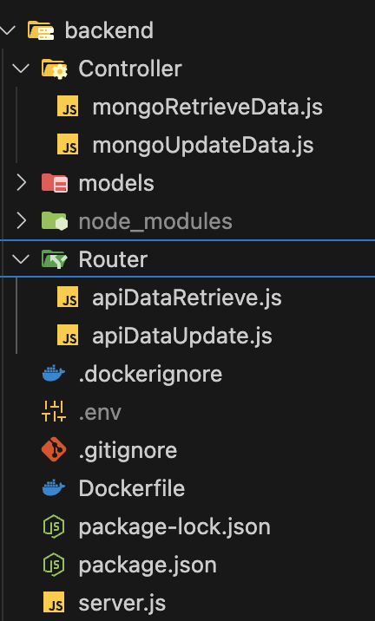
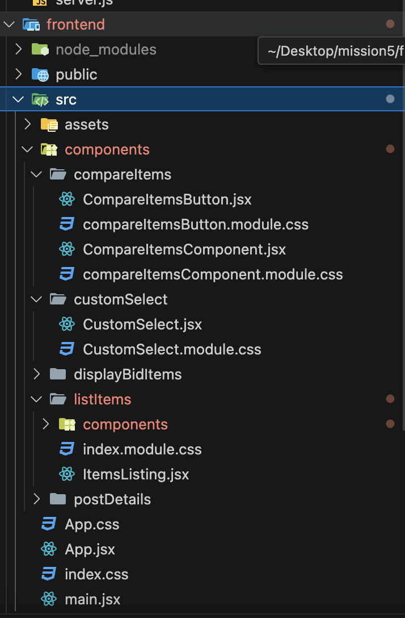
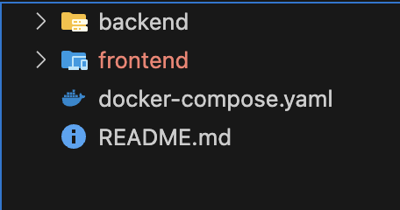
Folder Structure
Frontend
Backend
Main

Slide 5
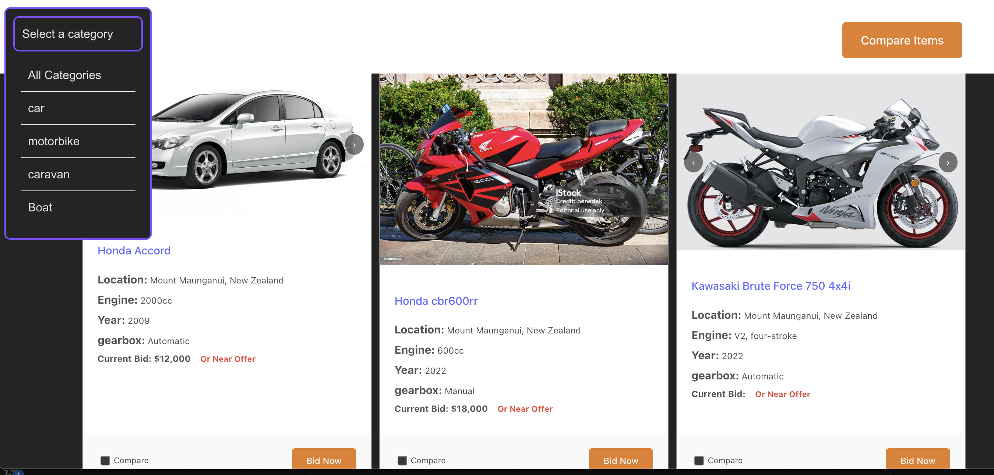
items- display
I used a simple item card to display items information

Slide 6
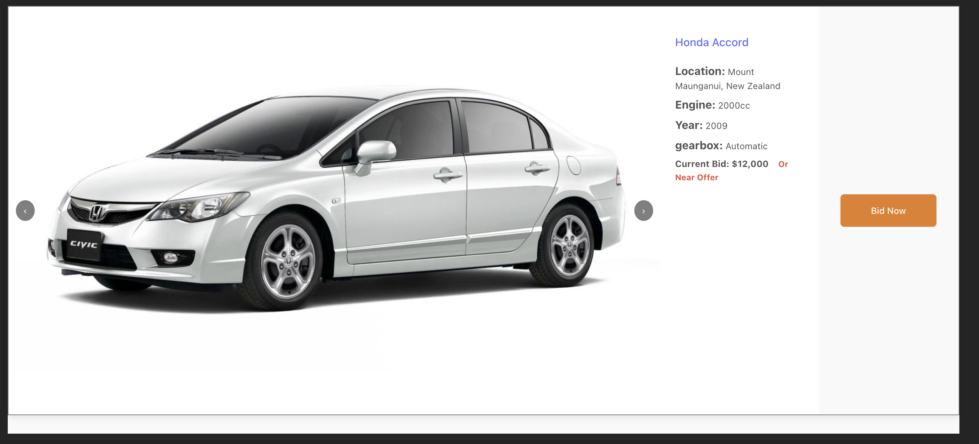
Display full item description
Clicking in each item wiil open a full screen item description to better view

Slide 7
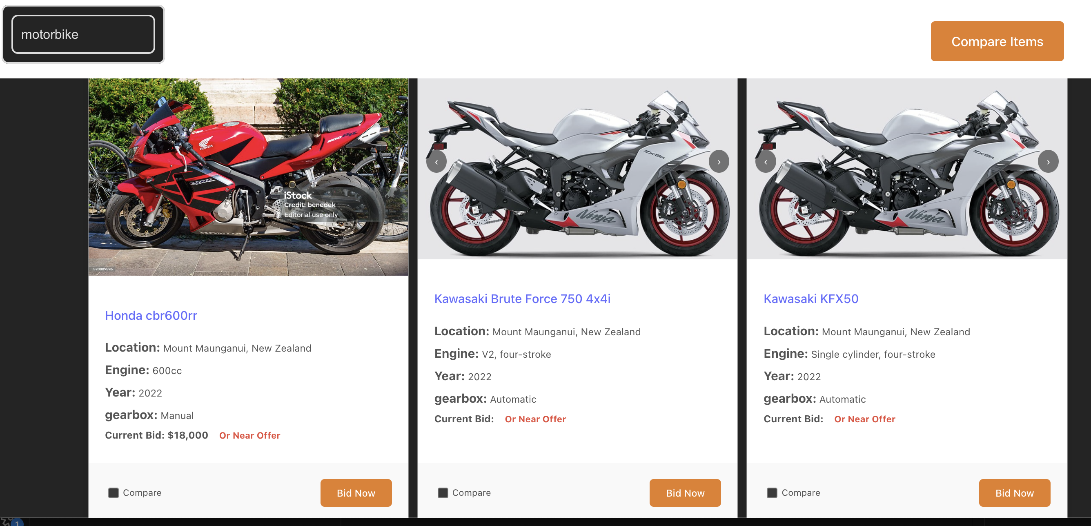
Display items from category
Display a select option to display and filtter items from diverent cattegories.

Slide 8
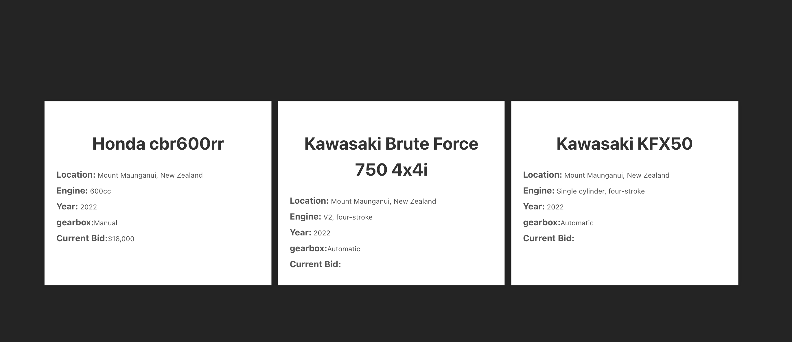
Frontend
Display compared items
Select each item that you want to compare
Click the compare button to display the selected items in a new screen

Slide 9
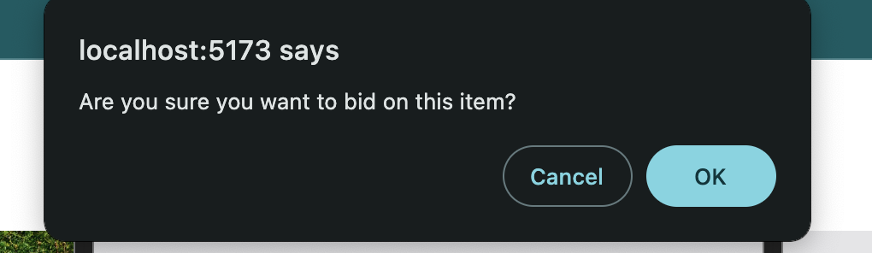
Bid confirmat
Display confirm popup to accept the bid before update the data base

Slide 10
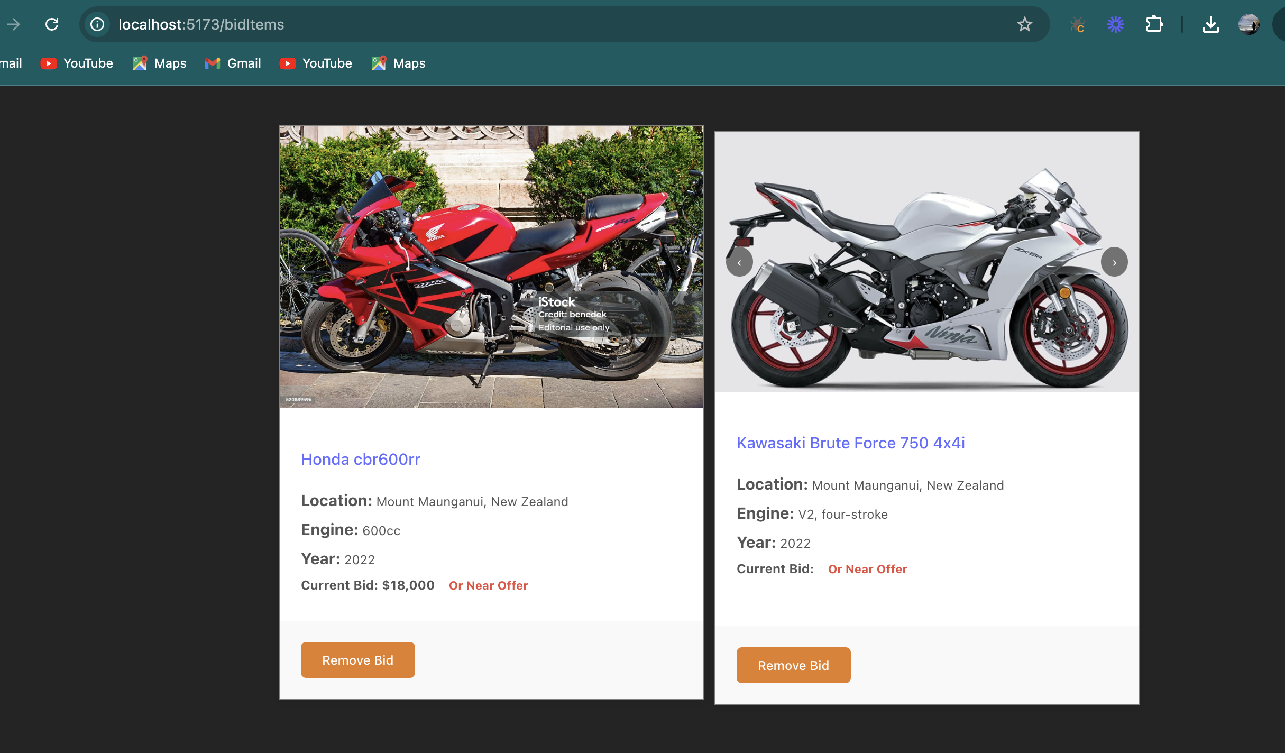
Display items that you have Bid
Display the items you have bid in a new screen

Slide 11

tradeMe
Thank you for you watching
The Insurance Assistance will be with you shortly.

